Slide 1
超越学科界限的认知基础 Transdisciplinary Cognitive Foundation
Image Source: Get your guide
Cybernetics: Control and Communication Week 08
Ben Koo
November 2, 2020

Slide 2
Glossary
Epistemology: How knowledge is acquired (dynamic process)
Ontology: How knowledge is organized (static image of knowledge)
Cybernetics: The control and communication of systems
All ideas can be represented as Kan Extension (Categorical Structures)
These Categorical Structures can be thought of as Partially Ordered Sets(POS)
Category Theory provides a mechanism to reuse information in these POSs
Programming Techniques can compress space/time as new information arises
Think about Memoization, Tail Recursion, Iteration

Slide 3
Prior to today’s lecture
All Knowledge represented by Named Functions
This set of rules can be used recursively to generate an infinite amount of expressions.
Variable
Expression1
Expression2
𝜆
Variable
Expression
( )
Expression

Slide 4
A Rhetoric Lens to see the world
Focus on the relational structures between Names
This set of rules can be used recursively to generate an infinite amount of expressions.
Variable
Expression1
Expression2
𝜆
Variable
Expression
( )
Expression

Slide 5
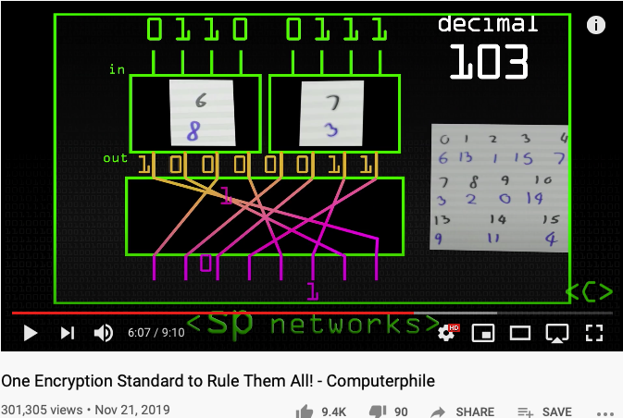
One Encryption Standard to Rule them All
AES replaced IBM’s DES standard because:
A longer (more secure) key length
Faster encryption

Slide 6
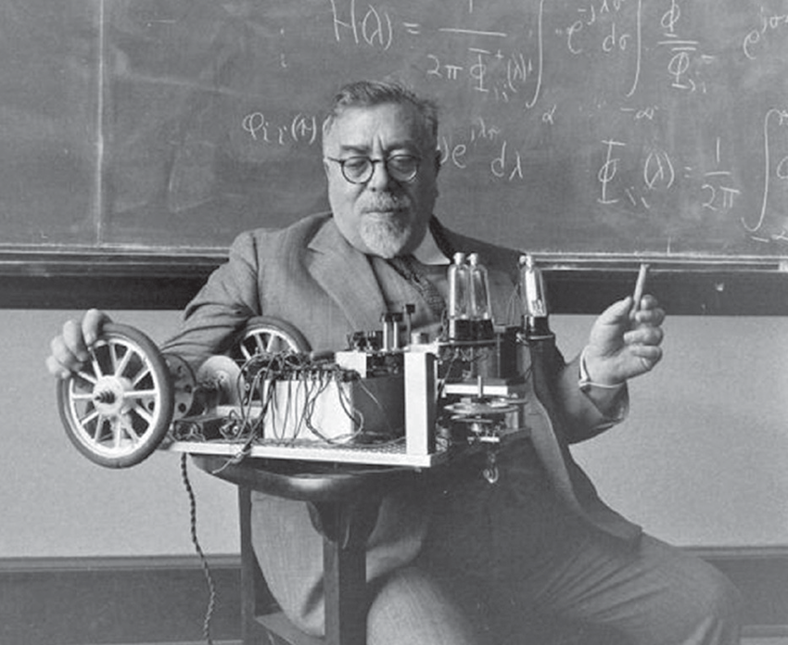
The Dominant Personality behind Cybernetics
Cybernetics:
the science of control and communication in the animal and the machine.
- Norbert Wiener
Image source: Research Gate download Link
Innovation occurs at the boundary of disciplines by competent people.
- Norbert Wiener

Slide 7
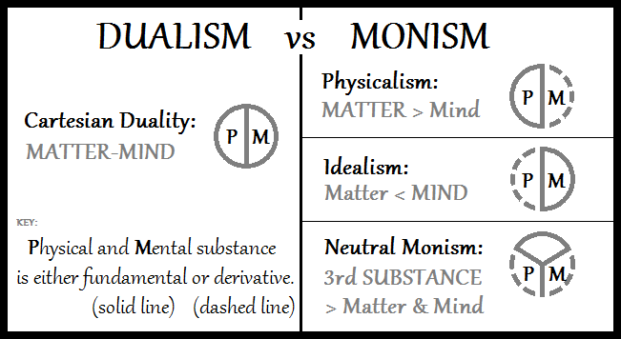
From Monism, Dualism to Cyber-physical Systems
Image Source: Double-aspect Theory on Wikipedia

Slide 8
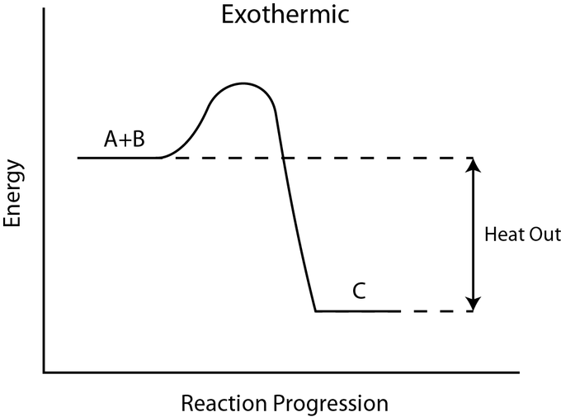
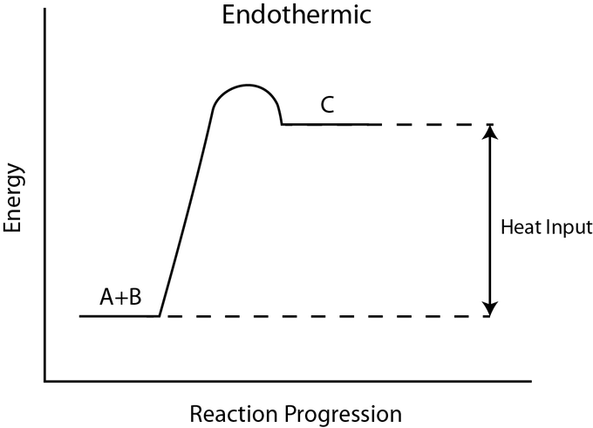
Exothermic and Endothermic
Image Source: exo and endothermic processes on Lumen Learning

Slide 9
Market Dynamics
Bearish Market
Bullish Market
Transaction Costs
Transaction Costs
Image Source: exo and endothermic processes on Lumen Learning

Slide 10
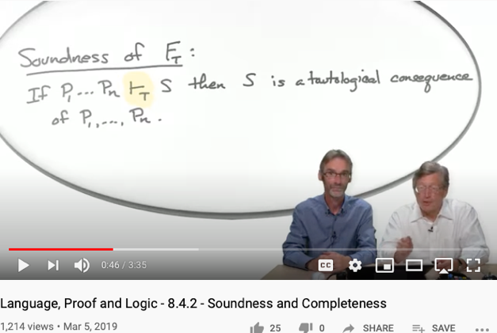
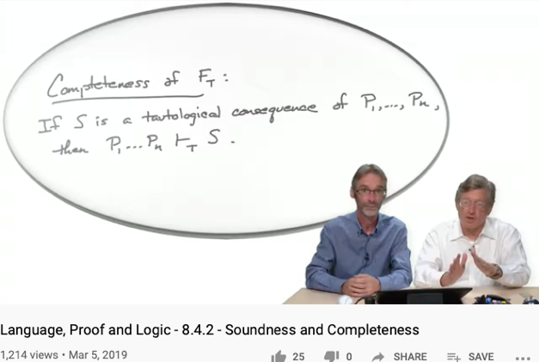
Soundness
Completeness
For engineering/scientific purpose, it is difficult to escape Monism
The unifying notion of “Truth” is the source of Monism
Every provable statement is true
Every true statement is provable
Cited from : Soundness and Completeness: With Precision on news.ycombinator.com
https://youtu.be/3hspKYIn5ds?t=29
https://youtu.be/3hspKYIn5ds?t=162

Slide 11
What is the big deal?
New instrumentation is giving Cybernetics to interact with human at different scales:
Many complex ethical concerns becomes everyday decisions
Consensus must be reached a higher frequencies than before
Choice of vocabulary is affecting the efficiency of search
User Interface Design and the nature of “Scalable Consensus”
Time and Space has been compressed to form new identities
Automated Verification Tools must be applied before any social commitment

Slide 12
Recognizing the Fact
All Knowledge represented by Named Functions
This set of rules can be used recursively to generate an infinite amount of expressions.
Variable
Expression1
Expression2
𝜆
Variable
Expression
( )
Expression

Slide 13
The Universal Structure in 𝜆-Calculus Form
Expression := Contextualized Data (* Known interpretation results, no computation *)
| Goal_Exp Criteria_Exp (* Timeless and Time-based expressions *)
| 𝜆 Input Output_Exp(Input) (* A Computing Process *)
| ( Exception_Handling ) (* Stated boundary conditions/Exceptions *)
This set of rules can be used recursively to generate an infinite amount of expressions.
What
Contextualized data
Goal Expr
Criteria Expr
Why
𝜆
Input
Output Spec
How
( )
Exception Handling

Slide 14

Recursive Structures as a Rewrite System
(Rewrite = Replacement)
Image Source: https://speakerdeck.com/glebec/lambda-calc-talk-frontside-version?slide=66

Slide 15
Monad is an actionable Abstraction
Image Source: https://speakerdeck.com/glebec/lambda-calc-talk-frontside-version?slide=66

Slide 16
Universal set of Replacement Rules
Expression := Variable (* Atomic results, replace nothing *)
| Expression Expression (* Expansive or One-to-Many replacement *)
| 𝜆 Variable Expression (* replace variable content in Expression *)
| ( Expression ) (* Isolate replaceable Expression with boundaries *)
This set of rules can be used recursively to generate an infinite amount of expressions.
Variable
Expression1
Expression2
𝜆
Variable
Expression
( )
Expression

Slide 17
This might look familiar
Expression := Contextualized Data (* Known interpretation results, no computation *)
| Head_Exp Tail_Exp (* Timeless and Time-based expressions *)
| 𝜆 Input Output_Exp(Input) (* A Computing Process *)
| ( Bounded_Exp ) (* Stated boundary conditions/Exceptions *)
This set of rules can be used recursively to generate an infinite amount of expressions.
Contextualized data
Head
Tail
𝜆
Input
Output Spec
( )
Bounded Expression

Slide 18
This meaning of “Equal”
Expression := Contextualized Data (* In a rewrite system, equal or := is a rewrite rule *)
| Head_Exp Tail_Exp (* this is a branching structure *)
| 𝜆 Input Output_Exp(Input) (* A simplification procedure*)
| ( Bounded_Exp ) (* Special case manipulation/Exceptions *)
For single threaded computation, all functions can be derived from here.
For multiple-threaded system, see 𝞹-calculus
Contextualized data
Head
Tail
𝜆
Input
Output Spec
( )
Bounded Expression

Slide 19
Controlling Types
A unique feature of Category Theory, is that it provides a meta-mathematical framework to introspect itself. This can be found in the way lambda calculus and the three types of functions, namely
Morphisms (Head label representing its tail or content)
Functors (An indirection that allows some intermediate replacement action)
Natural Transformations, (A kind of function that points to itself)
are defined. This mathematical framework uses only three types of functions (functions being the root type), to represent everything.
This flattened type examination mechanism, instill a universal discipline to check and verify soundness and completeness of all variations of structures, as well as values in any namespace, so that it provides the most succinct, yet overarching abstraction of all.
More importantly, this universal mechanism has been operationalized by computing machinery to offer both automation as well as scalable reasoning of type, so that it is becoming a foundational layer of our modern civilization. The incorrect or biased implementation of this mechanism, is the source of inequality in our society.

Slide 20
Relevance to Cybernetics
The control and communication of systems requires not just raw content, but a structure to manage the interpretation of implicit relationship between entities in a system. This has been a major hurdle that hasn’t be addressed in most other types of mathematical framework, until Category Theory.
Now, the type-based interpretation framework can be found in many fields of mathematics, partially due to the revelation in Logic, Lambda Calculus, and Category Theory. That all these implicit structures are isomorphically mapped to each other, also known as the “Curr—Howard-Lambeck Correspondence”.
It is because of this correspondence, and the universality of this correspondence, that makes people start thinking that all sciences and mathematical principles can only be discovered, not invented, because they must have already been there before one’s invention.
This is relevant to cybernetics, because in the field of control and communication, many ideas and techniques must have already been found and developed in math, and computing science, therefore, the techniques and knowledge in Cybernetics, must be re-discovering rules and properties that is already in Category Theory and other topological structures in nature.

Slide 21
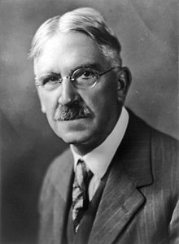
A philosophical way to interpret Self-Reference
“The self is not something ready-made, but something in continuous formation through choice of action.”
- John Dewey
On page 408 of the Philosophy of Education

Slide 22
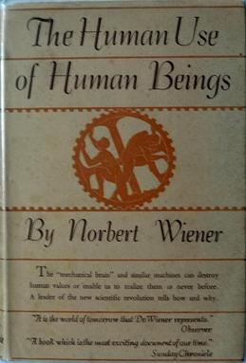
Cybernetics: The human use of human beings
The thesis of the book is that:
society can only be understood through a study of the messages and the communication facilities which belong to it; and that in the future development of these messages and communication facilities, messages between man and machines, between machines and man, and between machine and machine, are destined to play an ever-increasing part. (p. 16)
- Wikipedia on Human use of Human Beings
“Some agents can transcend one system and reset its goals from a vantage-point of a meta-system (Hofstadter, 1979). While many animals are capable of a wide repertoire of diverse goal-seeking activity, human minds appear to be (for now) in a unique position. .”
- Michael Levin in the computational boundary of “self”

Slide 23
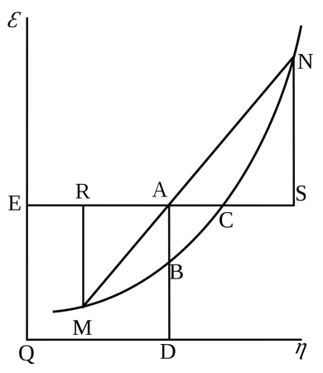
Cybernetics: Entropy and Negative Entropy
Wiener believed that communication of information is essentially negentropic – it resists entropy –, because it relies on organizational structures. There are two kinds of possible disorganizational forces, passive and active:
"Nature offers resistance to decoding, but it does not show ingenuity in finding new and undecipherable methods for jamming our communication with the outer world" (pp. 35–36).
- Wikipedia on Human use of Human Beings
Willard Gibbs’ 1873 available energy (free energy) graph, which shows a plane perpendicular to the axis of v (volume) and passing through point A, which represents the initial state of the body. MN is the section of the surface of dissipated energy. Qε and Qη are sections of the planes η = 0 and ε = 0, and therefore parallel to the axes of ε (internal energy) and η (entropy) respectively. AD and AE are the energy and entropy of the body in its initial state, AB and AC its available energy (Gibbs energy) and its capacity for entropy (the amount by which the entropy of the body can be increased without changing the energy of the body or increasing its volume) respectively.
- Wikipedia on Negentropy

Slide 24
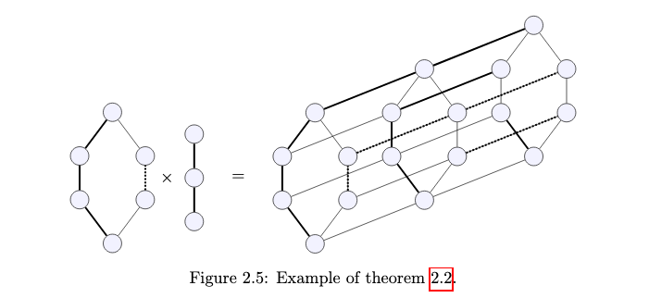
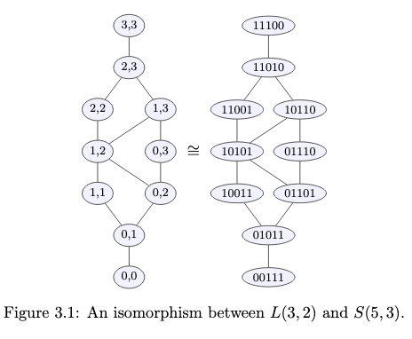
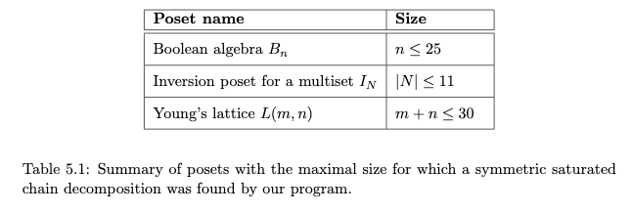
Entropic namespaces in Partially Ordered Sets
Image Source: Symmetric chain decompositions of partially ordered sets by Ondrej Zjevik

Slide 25
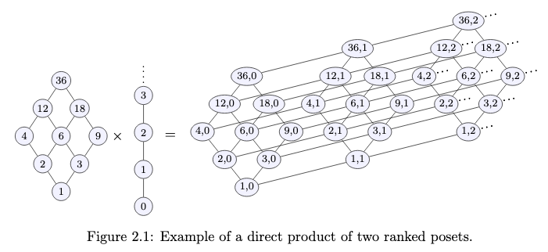
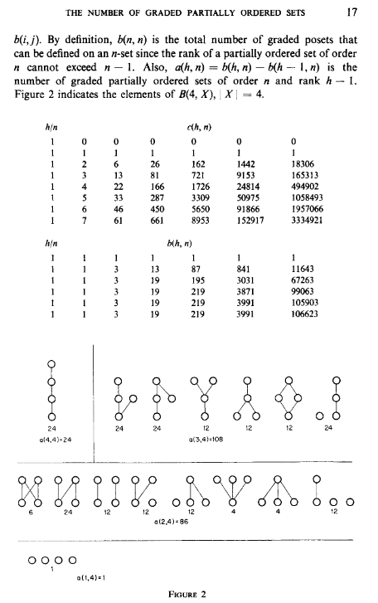
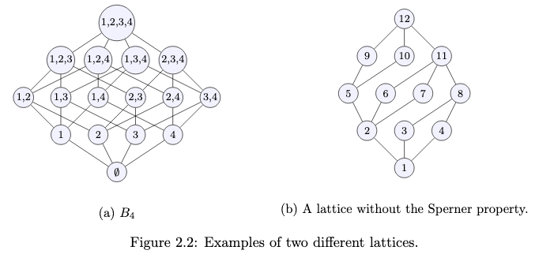
Poset as Composable Namespaces
Image Source: Symmetric chain decompositions of partially ordered sets by Ondrej Zjevik
Image Source: The Number of Ordered Partially Ordered Sets by David Klarner

Slide 26
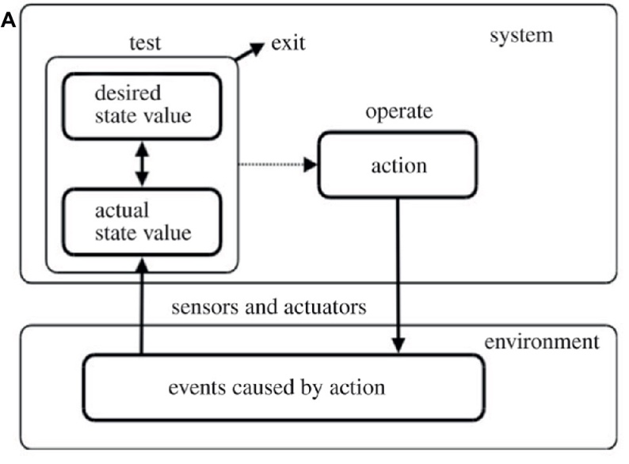
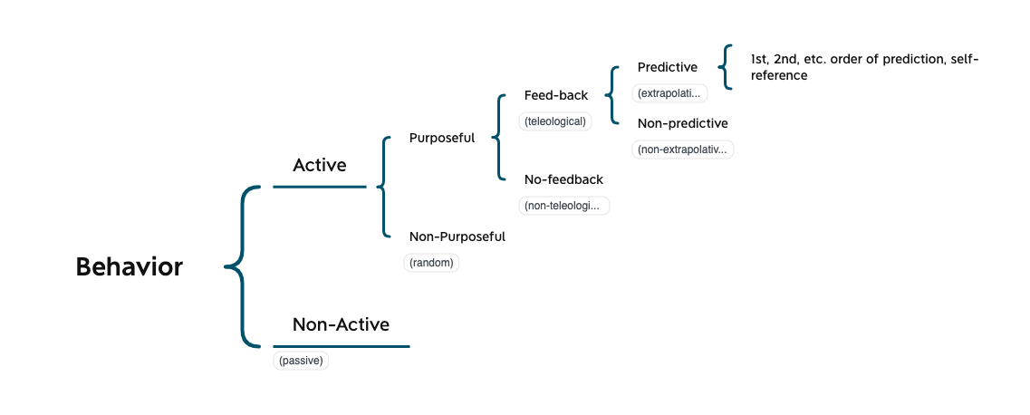
Scales of Control in Cybernetics
Figure 1 of The Computational Boundary of a “Self”

Slide 27
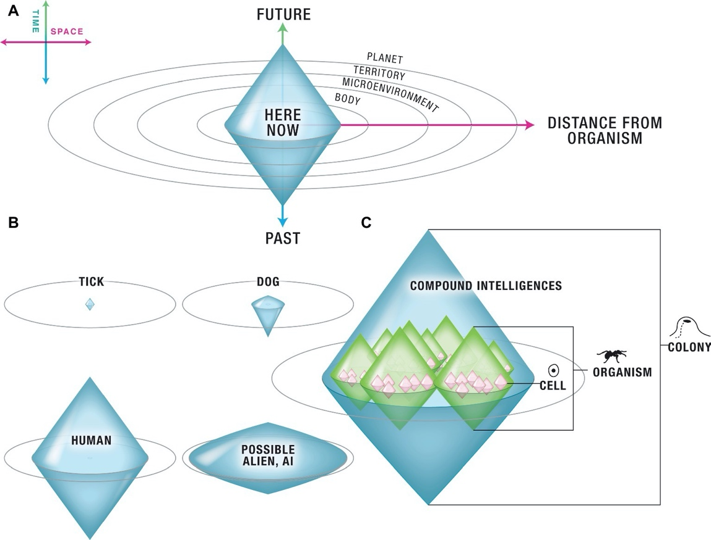
Controlled Boundaries (Poset) of different Scales
Figure 2 of The Computational Boundary of a “Self”

Slide 28
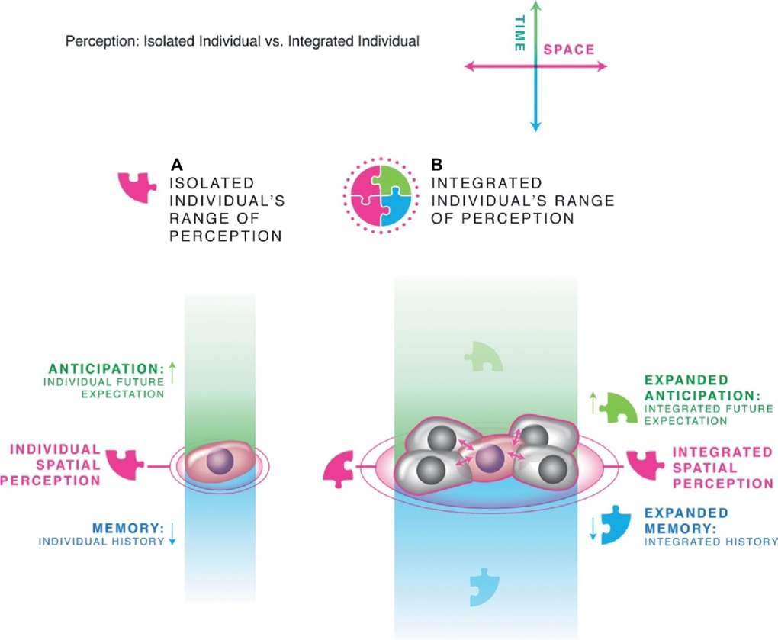
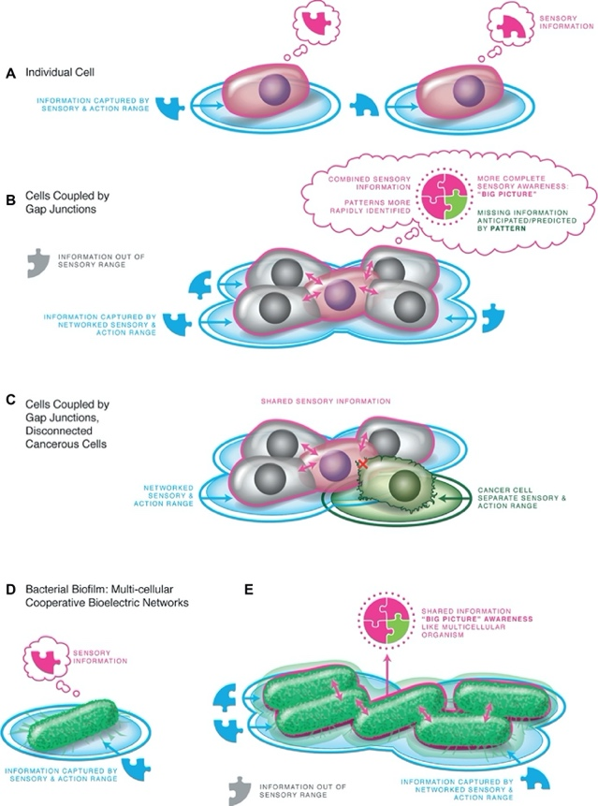
Controlled Boundaries of different Scales
Figure 3 and 4 of The Computational Boundary of a “Self”

Slide 29
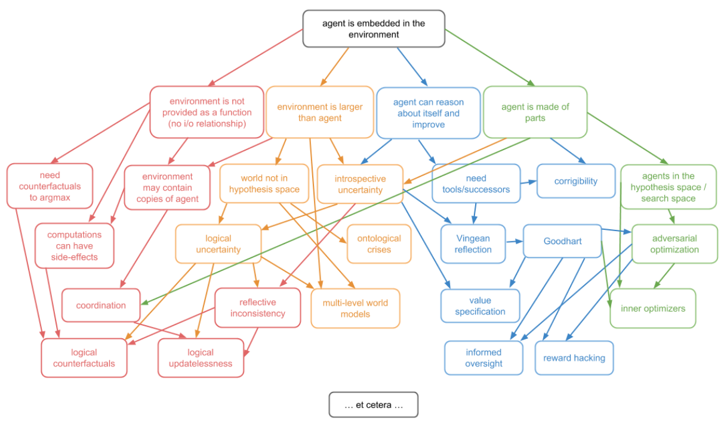
Control in the world of Posets
On P.4 of Embedded Agency

Slide 30
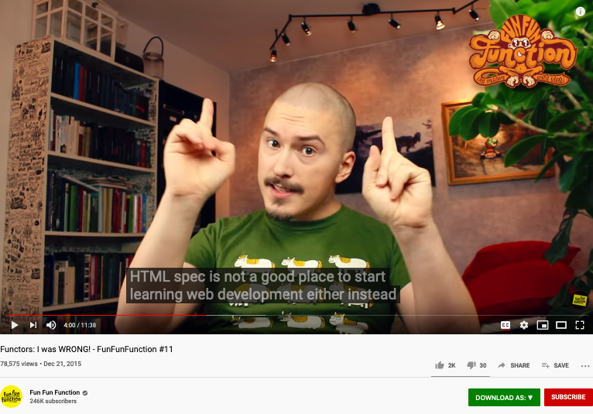
A cool video on Functors
https://youtu.be/DisD9ftUyCk?t=240

Slide 31
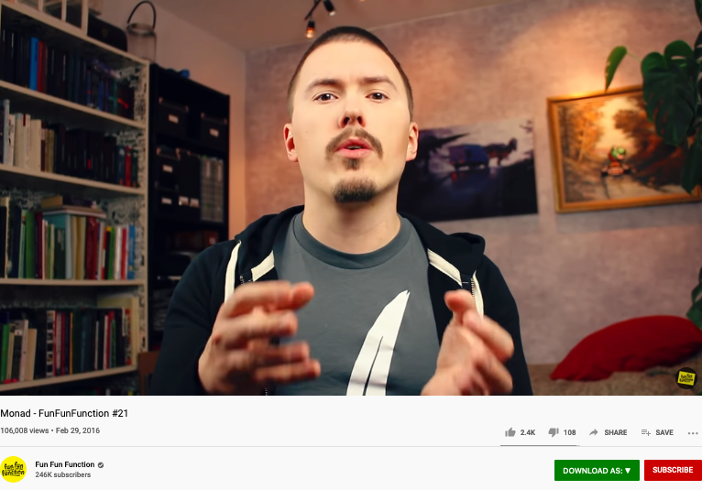
A cool video on Monad
https://youtu.be/9QveBbn7t_c

Slide 32

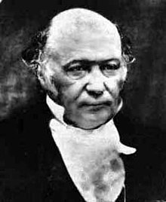
Hamiltonian Mechanics make energy Accountable
Assets = Liability + Equity
and
H = T + V
These two equations basically dominated two fields: Economics and Physical Sciences
Thinking from a Meta-Mathematical viewpoint,
they present a way to break down the total amount of conservative resources,
and therefore, allows iterative branching and therefore continuous replication.
Notes:
“historian James Aho linked double-entry bookkeeping to the ancient art of rhetoric,”
Excerpt From: Jane Gleeson-White. “Double Entry.” Apple Books.

Slide 33
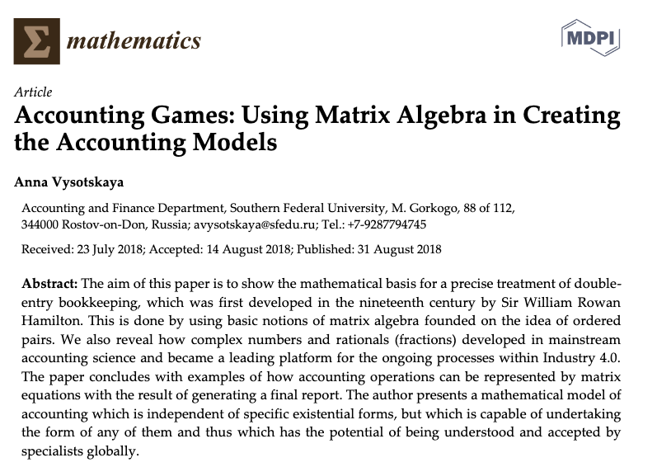

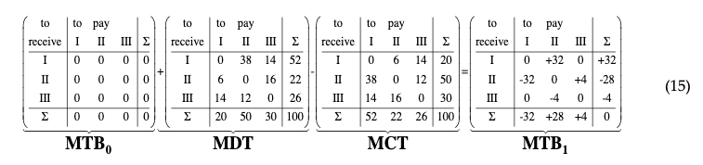
Hamilton did more work on the Accounting Equation
The aim of this paper is to show how the mathematical basis is used for a precise treatment of double-entry bookkeeping, which was firstly developed in the nineteenth century by Sir William Rowan Hamilton. This is done by using basic notions of matrix algebra with the roots to the idea of using ordered pairs. We also reveal how the complex numbers and the rationals (fractions) developed in a mainstream of accounting science and became a leading platform for the ongoing processes within the Industry 4.0.
Image Source: Research Gate
Notes:
In the presentation on Oct-9, 2020, Ray again, stated a link between the Atomic Explosion’s 20 thousands generations of chain reactions and the layers of Syntatic Trees in Chomsky’s Syntactic Theory about language. Then, he also reminded us that Chomsky and Shannon were working in locations that are 100 feet away from each other. The white and black dots are demonstrating the patterns of Fibonacci series.

Slide 34



Kuhn Cycle: recursion and symmetry-breaking
Keeping namespace consistent (is challenging)
Normal Science
Model
Drift
Model Crisis
Model Revolution
Paradigm
Change
Emerging cases or
systematic attacks
Ouroboros Snake
in five named stages

Slide 35
The second Language Design Strategy
combine structure with operations!
The isomorphism between accounting equation and the Hamiltonian formulation states: Science is about utilizing symmetries/invariance recursively.
Put the Accounting /Hamiltonian equation in a matrix structure, the addition operations becomes iterative.

Slide 36

Concrete Activities in Daily Workflow
What is DevSecOps?
Image courtesy: Paladion Corporation Website Image source: https://www.paladion.net

Slide 37
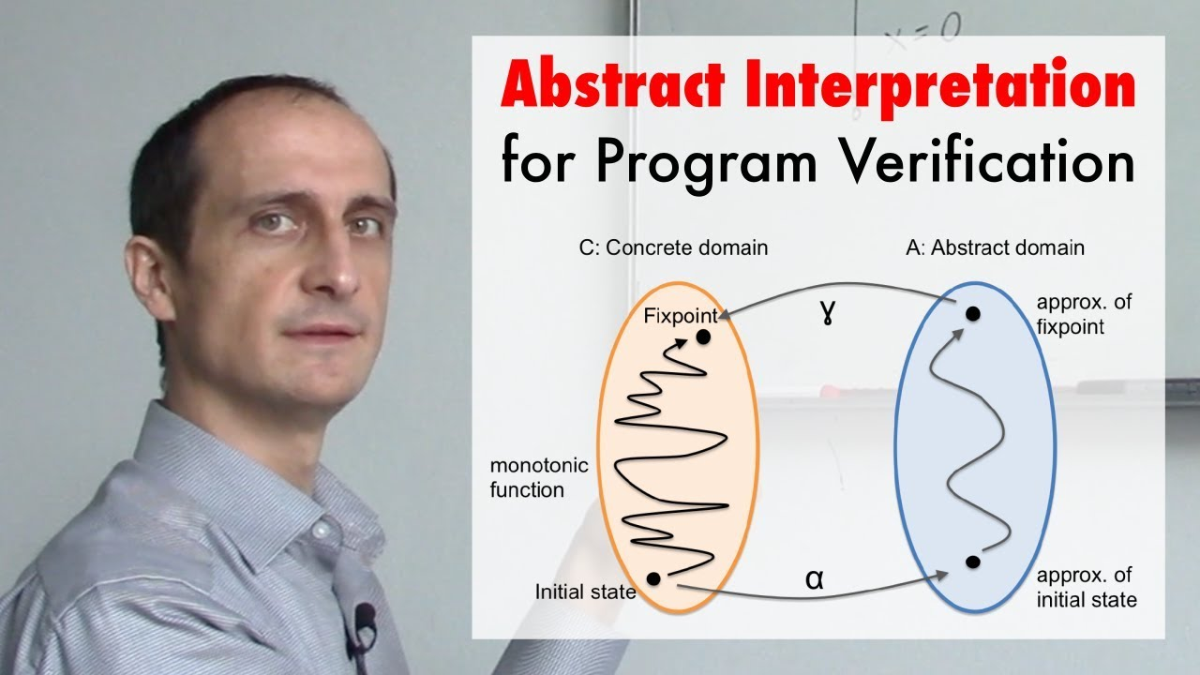
A short introduction video
https://youtu.be/j2m5YMnHvQQ

Slide 38
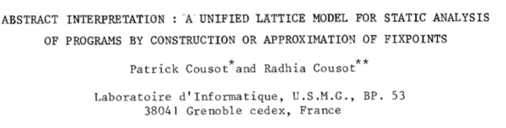

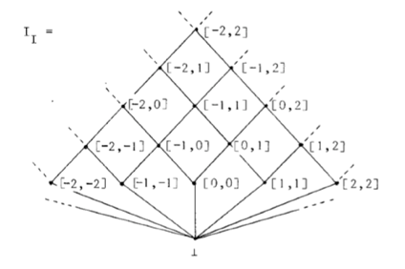
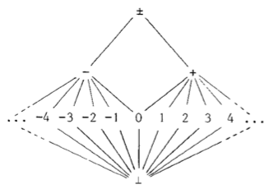
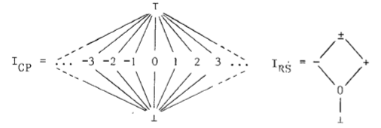
Connecting Abstract and Concrete Domains
4th POPL, pages 238-252, Los Angeles, CA, 1977. ACM Press.
Prof. Cousot and Koo in 2005
Course number: 16.399 Title: Abstract Interpretation Units: H level course, 3-0-9 Lecture hours: Tuesday 11:00–12:30 and Thursday 11:00–12:30 (see the course schedule for exceptions) Location: 33–419 Course web site: http://web.mit.edu/afs/athena.mit.edu/course/16/16.399/www Prerequisites: basic skill in mathematics and experience with computer programming.
Conclusion (the second paragraph)
There is a fundamental unity between all these apparently unrelated program analysis techniques : a new interpretation is given to the program text which allows to build an often implicit system of equations. The problem is either to verify that a solution provided by the user is correct, or to discover or approximate such as solution.
http://web.mit.edu/afs/athena.mit.edu/course/16/16.399/www/

Slide 39
Abstraction
Concretization
Why is abstraction useful?
Allow reuse through universal properties
Avoid resource conflicts
Scale free and domain neutral
Generalizing concrete experience?
Make analogies in localized contexts
Engage sensible metaphors
Define terms and boundaries
A well-defined set of Actions and iterative Branching Strategies
A Roadmap of composable activities
Sequencing and timing conditions
Explicitly state dependencies and resource requirements

Slide 40
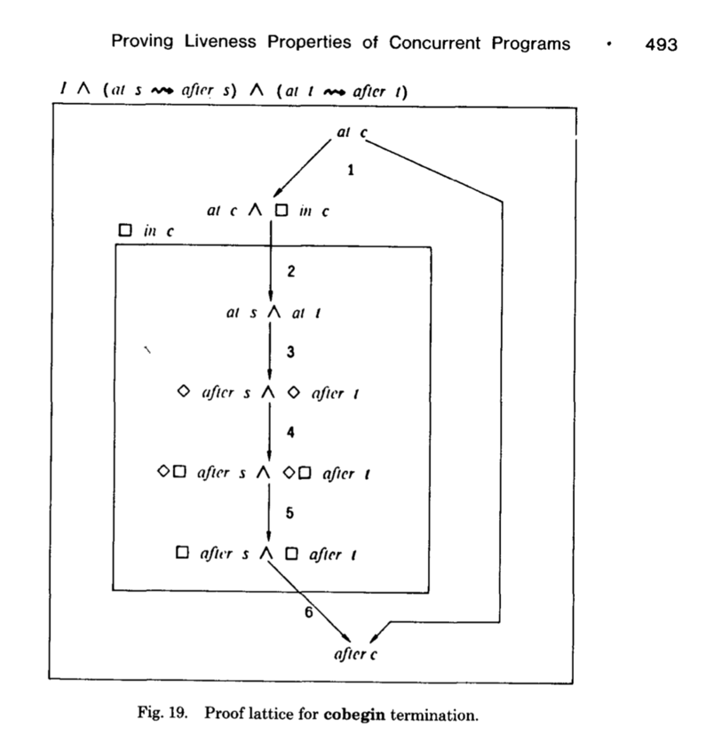
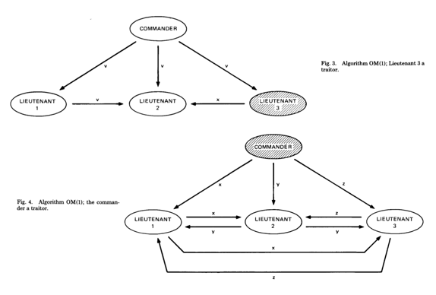
打破认知边界的传奇符咒
系统的两类合约：
安全与活性
Safety: （安全）
Something bad never happens
Liveness: （活性）
Something good eventually happen
The Byzantine Generals Problem * 388
找到了计算信息传递可信度的数学理论
拜占庭将军的问题：提出了分布式数据库的可信度检验算法
http://slideplayer.com/slide/4339032/
ACM Transactions on Programming Languages and Systems, Vol. 4, No. 3, July 1982.

Slide 41

Abstraction
Concretization
Why state objectives on paper?
Accentuate objectives in prescribed contexts
Define roles not persons
Objective law enforcement
Why specify key results?
Make explicit targets to orient actions
Assign responsibilities to persons
Fairness in Rewards/Punishment
A well-defined set of Actions and iterative Branching Strategies
A Roadmap of composable activities
Sequencing and timing conditions
Explicitly state dependencies and resource requirements
Namespace (Data Asset) Management

Slide 42
Think about all activities as Posets software projects in version control database
Normal Science
(commit)
Model
Drift
(build)
Model Crisis
(test)
Model Revolution
(stage)
Paradigm Change
(deploy)
Time Stamp
Time Stamp
Time Stamp
Time Stamp

Slide 43
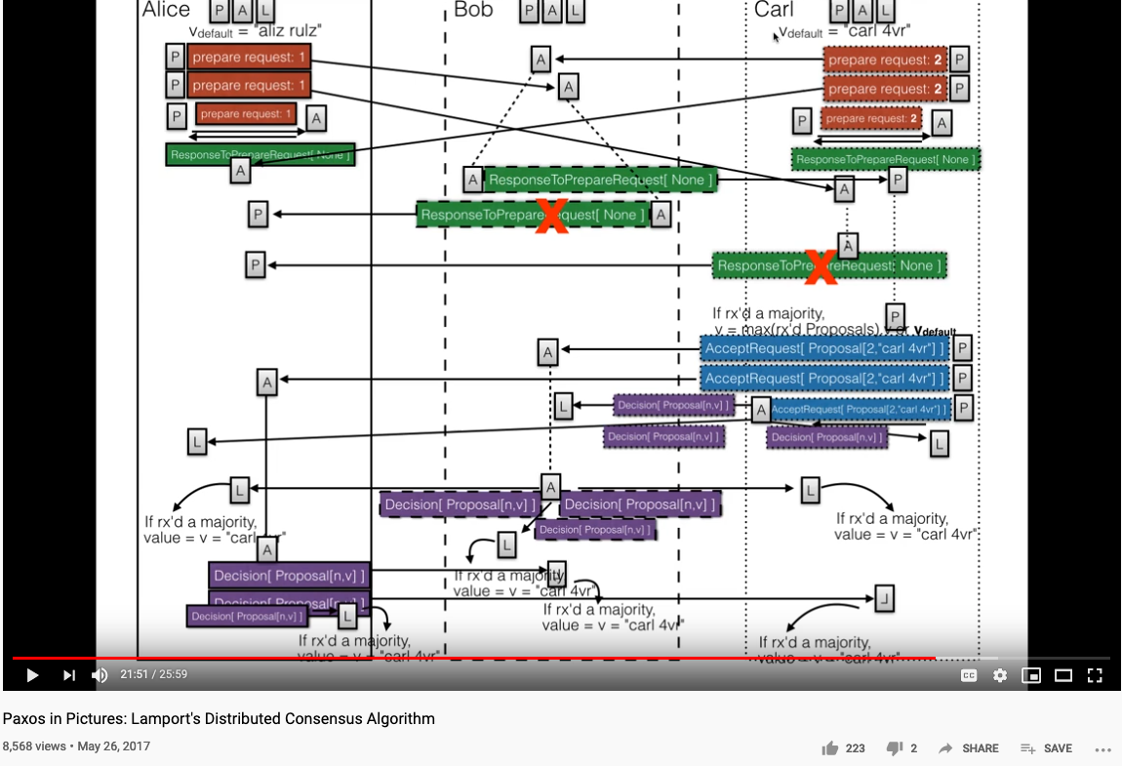
Paxos as a Poset

Slide 44
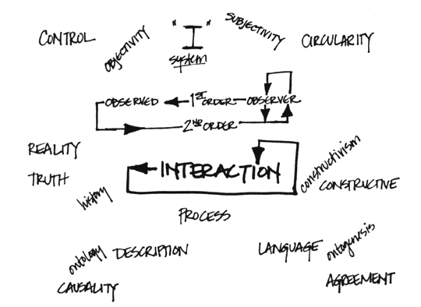
Why is Simplicity in NsM so Strategic
Controlled Entropy = Controlled Time
Think about Google’s interface
Why are they removing buttons on iPhone?
Bound Variables in Logics
When complexity is inevitable
Leverage the notion of symmetry
See Hermann Weyl’s quote on lacking information…
Image Source: Intro to System Science and Cybernetics,
Dr Paul Pangaro

Slide 45
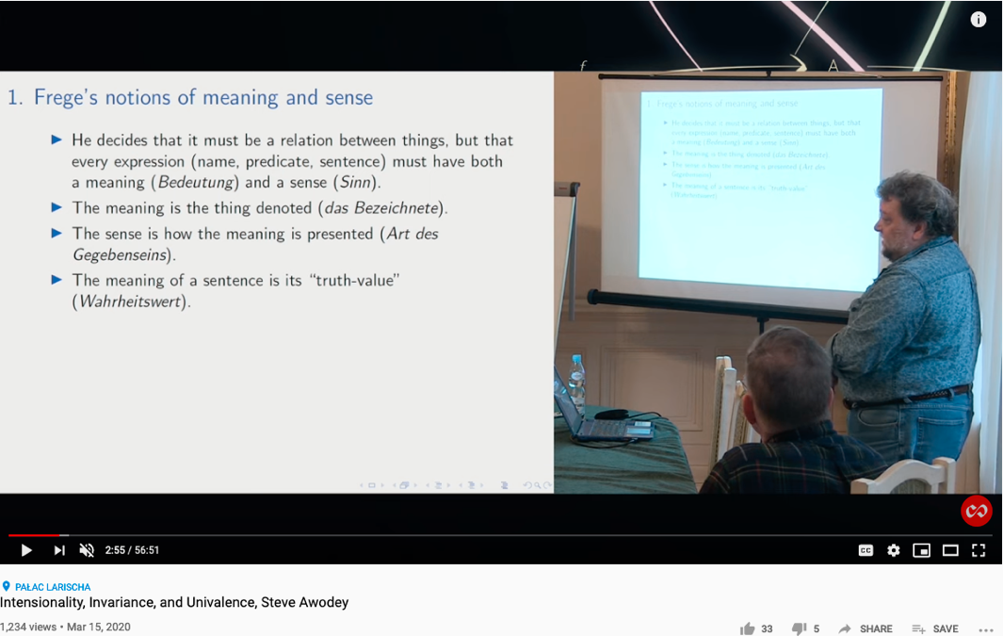
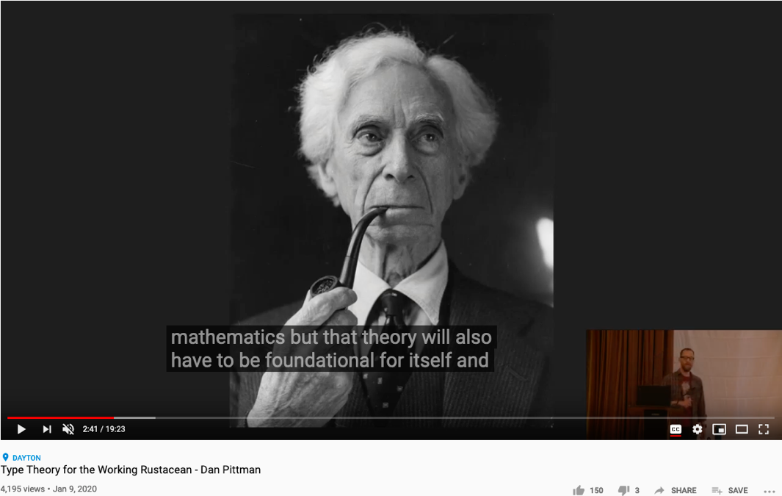
The Meaning of being True
Huawei VP Mr. Yang Shaoqing
RICH 70 Tsinghua SEA Cloud Forum, Sep 14, 2020
H. E. Bambang Brodjonegoro,
Minister of Research & Technology, Indonesia
Russel once said: “Mathematicians’ job is about classifiying.”
Mathematics is the art of giving the same name to different things.^{[10]} Henri Poincaré

Slide 46
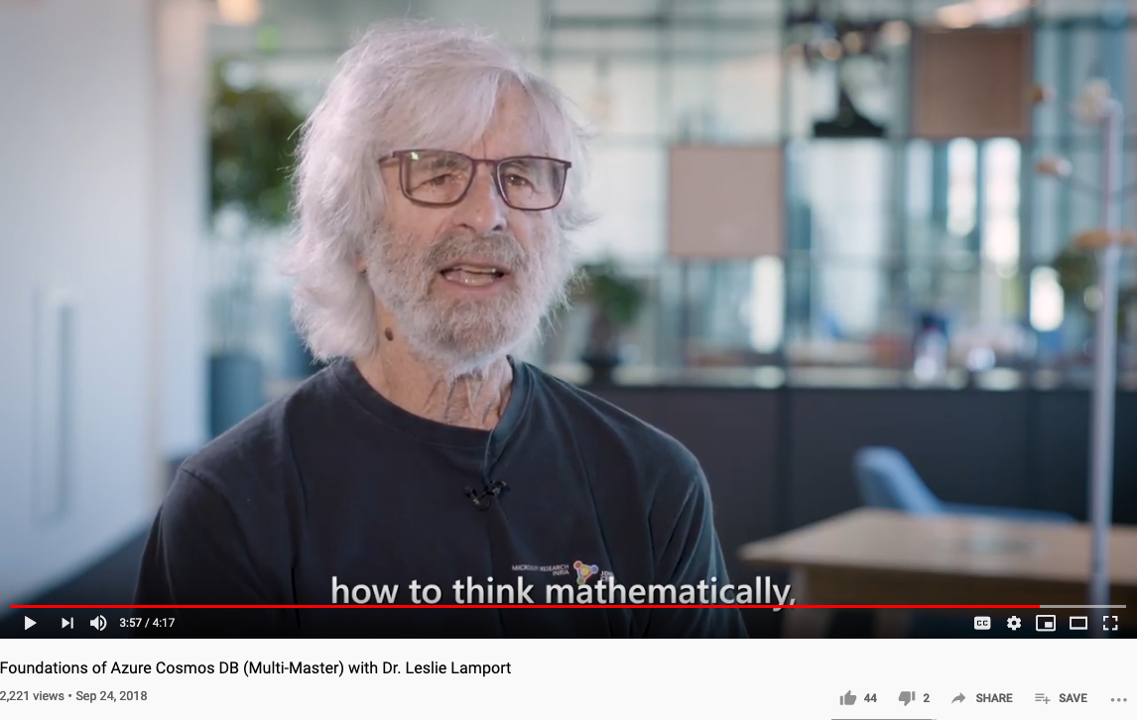
How to Think Mathematically?
Huawei VP Mr. Yang Shaoqing
RICH 70 Tsinghua SEA Cloud Forum, Sep 14, 2020
H. E. Bambang Brodjonegoro,
Minister of Research & Technology, Indonesia
Russel once said: “Mathematicians’ job is about classifiying.”
Mathematics is the art of giving the same name to different things.^{[10]} Henri Poincaré

Slide 47
Abstraction
Concretization
Safety
Nothing
bad happens
Liveness
Some
Good Things
Must Happen
A well-defined set of Actions and iterative Branching Strategies
A Roadmap of composable activities
Sequencing and timing conditions
Explicitly state dependencies and resource requirements
Correctness

Slide 48
Iteratively Fixing Security Problems
Technology Integration
Technology
Society
Security
Technology
Security
Society
Technology Isolation
Modified from Figure 1-1 and 1-2 of Agile Application Security: Enabling Security in a Continuous Deliver Pipeline,
by Laura Bell, Michael Brunton-Spall, Rich Smith & Jim Bird, O’Reilly Media, 2017

Slide 49
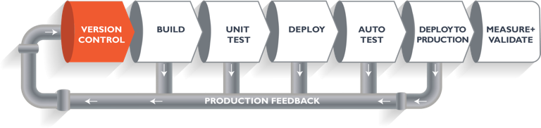
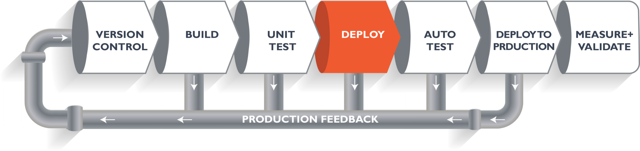
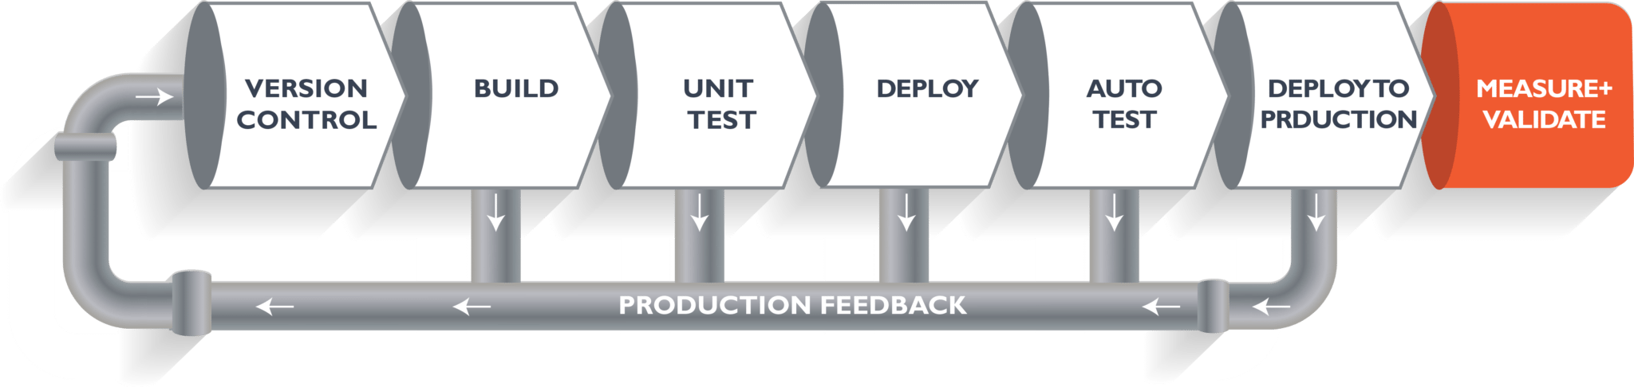
The Version Control, Built, Test, Stage, Deploy are Conducted by Human Instructions
Think of a multi-staged snake…
Image courtesy: Learn How to Set Up a CI/CD Pipeline From Scratch on DevOps Zone

Slide 50
A compositional view of system correctness
Liveness
Safety
Correctness
The Theoretical Definition of System Correctness
Correctness = Liveness ∧ Safety
Liveness: Something good eventually happens
Safety: Nothing bad ever happens

Slide 51

The Commit-Built-Test-Stage-Deploy are Fully Automated
Image courtesy: Learn How to Set Up a CI/CD Pipeline From Scratch from DevOps Zone

Slide 52
Continuously Adjust the Correctness Area
Liveness
Safety
Correctness
The Inremental Change Approach promoted by DevOps/CICD practitioners

Slide 53
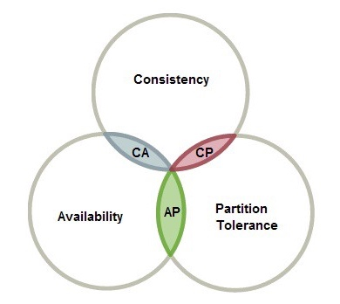
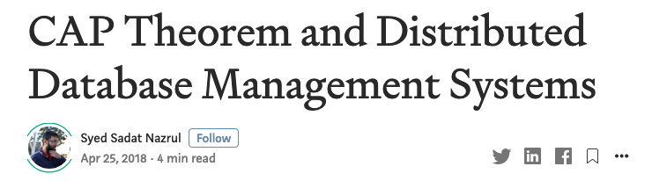
The CAP Theorem in NsM
RICH 70 Tsinghua SEA Cloud Forum, Sep 14, 2020
H. E. Bambang Brodjonegoro,
Minister of Research & Technology, Indonesia

Slide 54
Abstraction
Concretization
Choose a namespace (language)
Given resource bounds, satisfy functional soundness and completeness
Specify what is safe
Specify what is alive
Create the namespace (language)
Use TLA+ and K-framework to ensure satisfaction
Reason about safety via static analysis
Assess liveness via dynamic analysis (execute test runs)
A well-defined set of Actions and iterative Branching Strategies
A Roadmap of composable activities
Sequencing and timing conditions
Explicitly state dependencies and resource requirements

Slide 55
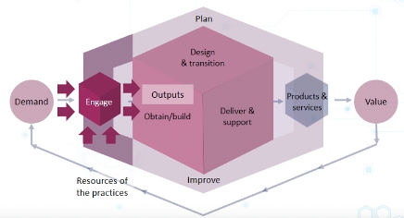
Abstract Specification
Concrete Implementation
A well-defined set of Actions and iterative Branching Strategies
A Roadmap of composable activities
Sequencing and timing conditions
Explicitly state dependencies and resource requirements
Namespace Management

Slide 56
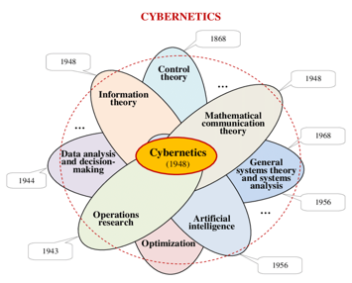
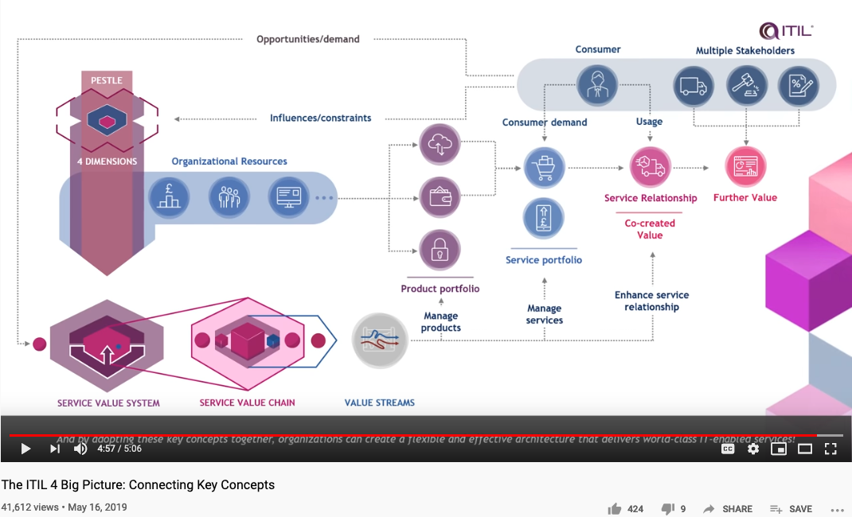
Cybernetics at a Scale of Internet Economy

Slide 57
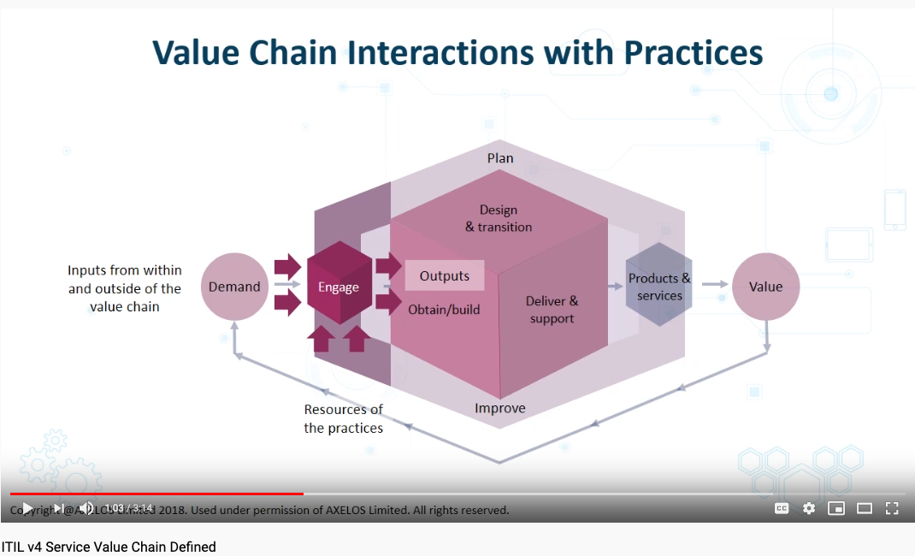
The Service Value Chain of the Networked Economy

Slide 58
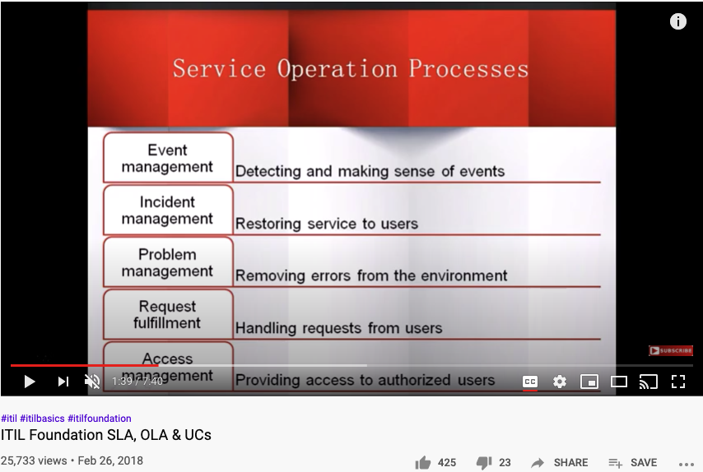
SLA, OLA, and UC
Acronyms
SLA: Service Level Agreement
OLA: Operational Level Agreement
UC: Underpinning Contracts
ITIL (IT Infrastructure Library)
Namespace management for IT services
A new industry standards body

Slide 59
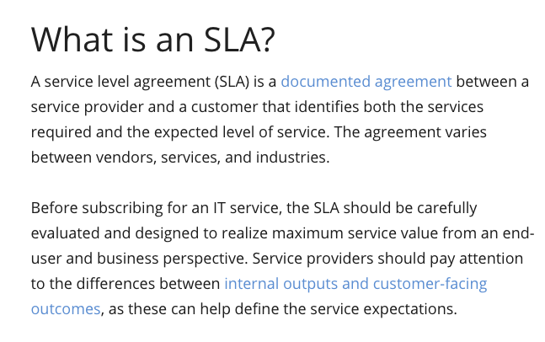

Abstract Specification Format IT Service Management through SLA

Slide 60


Concrete Implementation ITIL: Accounting System for Safety and Liveness
RICH 70 Tsinghua SEA Cloud Forum, Sep 14, 2020
H. E. Bambang Brodjonegoro,
Minister of Research & Technology, Indonesia
p.33 of ITIL for Dummies
By Peter Fareden
p.97 of Effective IT Service Management to ITIL and Beyond
By Rob Addy

Slide 61

ITIL’s Service Classification
Image Source: ITIL for Dummies P.74
The Cabinet Office refers to UK’s Cabinet.

Slide 62

Types of Digital Assets
Asset Container | Operations | Tools
File(Document) | Content Editing | MediaWiki
File Directories | Changing File Structures | Git
Micro Services | Execute Programs | Docker
Configuration Data | Deployment & Maintenance | Kubernetes
Physical Environment | Physical Actions | Hackerspaces

Slide 63

Digital Tools in Software Containers

Slide 64














Computing Architectures associated with Tools
Abstract Specification
Cloud Computing
Deterministic
Probabilistic
Centralized
Hybrid
Distributed
Single/Multi Core
Many Core
Single Site
Multi Site
Many Site
Hackerspaces
Super Computing Center
Notes:
64

Slide 65

Why is this a big deal?
With data content becomes
Trust-worthy, Provably correct (TLA+)
Privately searchable (Elastic Search)
Tailored for personal use
A publicly admitted pricing system
Account Management
Privacy Protection

Slide 66





You are in the Universal Namespace, now!
Library of
Linked Knowledge
(Data Plane)
Library of Executable Algorithms
(Control Plane)

Slide 67








How to organize a unifying Trust-worthy Namespace?
Ground in arithmetic rules (Gödel Numbering)
Organize knowledge in terms of Meta-Mathematics
Store content in Distributed Hyperlinked Databases

Slide 68

In DevOps/CICD Jenkins holds the key!
Jenkins enables all system-level actions to be triggered with properly assigned names.

Slide 69

Jenkins actions are managed in the Namespaces of Plug-ins

Slide 70
Summary
Writing (Data recording) enables accountability
Create collective consciousness across spacetime
NsM reasoning through Abstract Interpretation and K-Framework
Temporal Reasoning using TLA+,
Written records became valuable through Namespace Management (NsM)
Generic Consensus Algorithms enable distributed processes to effectively accountable
NsM is achieved through Proposal -> Learning -> Syncing -> Expiring cycles
Use a unifying Abstraction to separate Structures from Processes
Concrete Data values are captured using scalable IT infrastructures
Generic writing and accounting system as Knowledge Management Standards (ITIL)

Slide 71
Your actions before Oct 19, 2020
Start using Templates and Categories on toyhouse.wiki:81
Create a page about your project, using standardized Templates and Category
Make sure all Wiki pages you created follow the same Namespace convention
Start using Github to download and share files with proper NsM
Couse Github @ https://github.com/benkoo/CognitiveFoundation2020
Start writing your learning report.
Every week should include Logic Model using the standard Template
500 words or more per week

Slide 72


A Pioneering book in Transdisciplinary Studies

Slide 73

Table of Content

